Slide 1
AI, Assumptions and bias

Slide 2
Assumptions
An assumption is an unproven or untested belief, thought, or hypothesis that is accepted as true without concrete evidence.
Assumptions can be:
1. Unconscious (not realizing you're making one)
2. Based on incomplete information
3. Influenced by personal experiences or cultural background
Example: "He's probably tired today because he looks sleepy." (assuming without knowing the facts)

Slide 3
Assumptions about the Future
Making assumptions about the future is not a problem but believing that they are facts can be.
There are no facts about the future
To critically evaluate information:
Recognize assumptions and challenge them with evidence.
Identify potential biases and consider alternative perspectives.
Seek diverse sources and objective data.

Slide 4
Bias
Refers to a systematic or inherent predisposition, prejudice, or distortion that influences thinking, perception, or decision-making.
Biases can be:
Cognitive (mental shortcuts or heuristics)
Emotional (based on feelings or attitudes)
Cultural (shaped by societal norms or values)
Example: Back Benchers are incompetent and slow learners

Slide 5
Bias
Bias often leads to assumptions and can result in:
Skewed interpretations
Discrimination
Inaccurate judgments
Example: "Women are naturally better caregivers than men." (gender bias leading to an assumption)

Slide 6
Key differences
Assumptions are specific, individual beliefs, whereas biases are broader, systemic predispositions.
Assumptions can be corrected with evidence, whereas biases often require self-awareness and intentional effort to overcome.
Assumptions might be harmless, whereas biases can lead to harmful consequences.

Slide 7
Bias in AI can be introduced in many forms, from data to methods and algorithms, and it negatively affects people as well as research quality.
It also impacts upon an increasing amount of areas, including sensitive ones, such as healthcare, law, criminal justice, hiring.
An important task for researchers is to use AI to identify and reduce (human or machine) biases, as well as improve AI systems, to prevent introducing and perpetuating bias.

Slide 8
Categories of bias in AI
•
Researchers have identified three categories of bias in AI:
•
Algorithmic prejudice occurs when there is a statistical dependence
between protected features and other information used to make a
decision.
Negative legacy refers to bias already present in the data used to train the AI model.
Underestimation occurs when there is not enough data for the model to make confident conclusions for some segments of the population.
•
•

Slide 9
Sources of Bias
Training Data: If the data used to train an AI model reflects historical inequalities or stereotypes, the model can learn and perpetuate these biases. For instance, if a hiring algorithm is trained on resumes from a historically biased hiring process, it may favor certain demographics over others.
Feature Selection: The choice of features included in the model can introduce bias. For example, using postal codes as a feature can unintentionally correlate with racial or socioeconomic status.
Model Design: Certain algorithms may inherently amplify biases present in the data. Some models may be more sensitive to imbalances than others.

Slide 10
Consequences of Bias
Discrimination: Biased AI can lead to unfair treatment in areas like hiring, law enforcement, lending, and healthcare.
Erosion of Trust: If people perceive AI systems as biased, it can erode trust in these technologies and the organizations that deploy them.
Reinforcement of Stereotypes: Biased outcomes can reinforce societal stereotypes and systemic inequalities.

Slide 11
Mitigation Strategies
Diverse Data Collection: Ensuring that training data is representative of all groups can help mitigate bias. This includes actively seeking out underrepresented populations.
Bias Audits: Regularly auditing AI systems for bias can help identify and correct unfair practices.
Transparency: Making algorithms and their decision-making processes transparent can help stakeholders understand how decisions are made and hold organizations accountable.
Ethical Guidelines: Establishing and adhering to ethical guidelines in AI development can help prioritize fairness and equity.
User Involvement: Involving diverse users in the design and testing phases can provide valuable perspectives on potential biases.

Slide 12
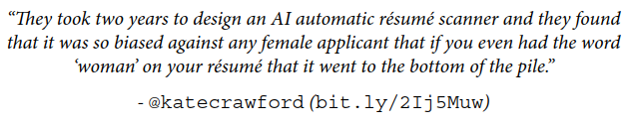
AI in hiring and recruitment
Mounting evidence and case studies that AI based hiring systems amplify existing human biases. Express discrimination based on race and gender.
Research conducted by AI Implicit Bias Lab found that AI-powered platforms “reflect, recreate, and reinforce anti-Black bias....”
Job applicants’ user profiles such as language, video, or voice data have lots of places where bias can lurk.
Amazon’s algorithm was applied to CVs, it quickly learned the bias to prefer male candidates over female ones (the disparate impact), and therefore, penalized resumes that contained the word vectors in the vicinity of women, such as
women's chess club captain.

Slide 13

AI in hiring and recruitment
Follow it here: https://github.com/daviddao/awful-ai.

Slide 14
AI in hiring and recruitment
Follow it here: https://github.com/daviddao/awful-ai.

Slide 15

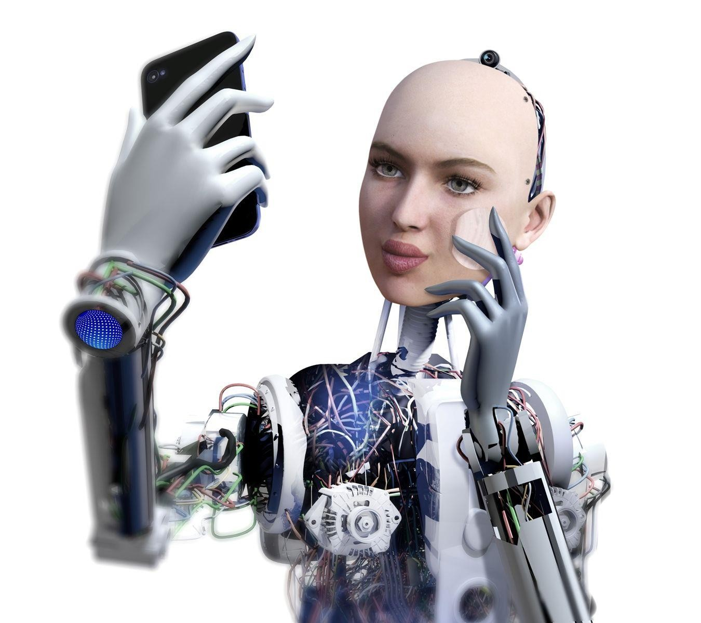
Meet Microsoft twitter chatbot: Tay
A chatbot is a form of AI which conducts a conversation via auditory or textual methods
A
t
shut down 16 hours after launch
released March 23 2016
learns from interacting
with people on twitter
official apology on Microsoft
blog
Twitter ‘trolls’ took
advantage of Tay's "repeat after me" capability by deliberately inputting offensive messages
mimicks the language
patterns of a 19-year- old American girl
inflammatory and
racist outputs from Tay

Slide 16
AI in Policing and surveillance
Predictive policing is an object of major concern where police departments can predict hotspots for future crime.
AI is being provided with input such as social media messages, which are then combined with satellite imagery to predict dissent gatherings and mass protests.
For Uyghurs, specialized cameras were used to automatically identify one of the world’s most persecuted minoritiesusing Anyvision’s Facial Recognition, which was previously funded by Microsoft.
Over-policing the neighborhoods of people of color, essentially exacerbating the existing situation.

Slide 17

COMPAS Algorithm: Correctional Offender
Management
Profiling
for
Alternative
Sanctions
used in state court
systems throughout the
United States
predicts
likeliness of criminal reoffending;
Black defendants
were almost
twice as likely to be misclassified with a higher risk of
reoffending (45%) in comparison to their white counterparts (23%).

Slide 18
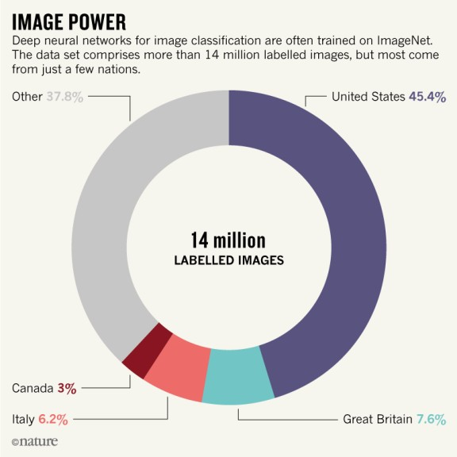
Bias: Skewed input data
•
•
Nature, 2018: https://www.nature.com/articles/d41586-018-05707-8
ML trained on large, annotated data sets (ImageNet, a set of more than 14 million labelled images; NLP: corpora of billions of words)
Sources: Google Images, Google News, w. specific query terms;
Wikipedia. Annotated via e.g. Amazon Mechanical Turk.
Issue:
• some groups over-represented, others are under-represented.
• > 45% of ImageNet data, is from US, (4% world population). China & India
contribute 3% of ImageNet data & represent 36% of the world’s population.
•
•

Slide 19

Ads
Facebook
Ads tailored to demographic background
Facebook said that
they have “made
important changes”
jobs such as nurses, secretaries and preschool
teachers were suggested primarily to women
job ads for janitors and taxi drivers had been shown to a
higher number of men, moreover men of minorities

Slide 20
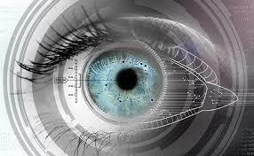
GIPHY: Gender
classification
via
iris
information
machine learning algorithms can
work out someone's gender from a
picture of their iris
images of eyes with
and without eyeliner
gender from eye makeup?

Slide 21

Facebook translation
• in October 2017 the Israel police mistakenly arrested a Palestinian after
relying on automatic translation software. The service translated a
picture of the construction site worker "good morning" as "attack them".

Slide 22

Apple’s
new
credit
card
Goldman Sachs, which issues the
card, said its credit decisions
were “based on a customer’s
creditworthiness and not on
factors like gender, race, age,
sexual orientation or any other
basis prohibited by law.”
Apple’s new credit
card may give
higher limits to men
than to women

Slide 23




Google & Amazon
•
artificial intelligence services from Google and Amazon
both failed to recognize the word “hers” as a pronoun,
but correctly identified “his.” (Nov 11, R. Munro)
Today, “hers” is not recognized as a pronoun by the most
widely used technologies for Natural Language Processing
(NLP), including (alphabetically) Amazon Comprehend, Google
Natural Language API, and the Stanford Parser.

Slide 24
Bias in archives, libraries
•
List of statements on bias in library and archives description –
Cataloging Lab
•
Australian Institute of Aboriginal and Torres Strait Islander Studies
(AIATSIS). [Sensitivity message appears as a pop-up with information
about language used in resources]
Australian War Memorial. Disclaimer [along with pop-up with
information about language used in resources]
Brown University Library. Terminology [statement on African
American history description]
…
•
•
•
Silence and Bias in Archives - Archives and Special Collections -
Archival silences refer to the erasure of archives, and histories
of marginalized communities within traditional archival
holdings.
Research Guides at Ryerson University Library

Slide 25
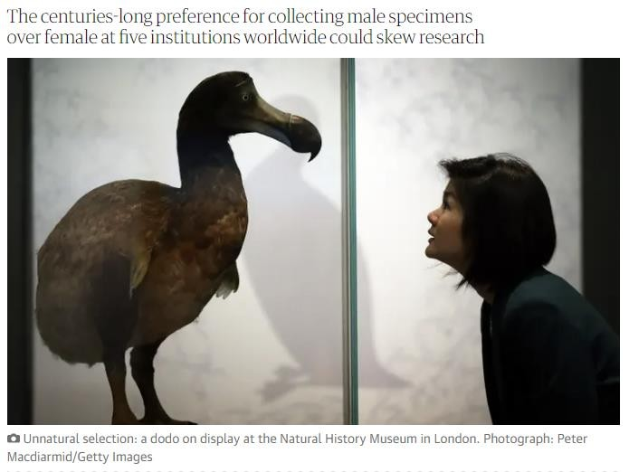
Bias in museums
• Why sexist bias in natural history museums really matters | Science |
The Guardian …
Museums & Truth. The Truth
is, there is More Than one
Truth! - MuseumNext
a stereotypical museum
culture which focuses on
collecting and showcasing
the stories, successes, and
works of the white male in
society.

Slide 26
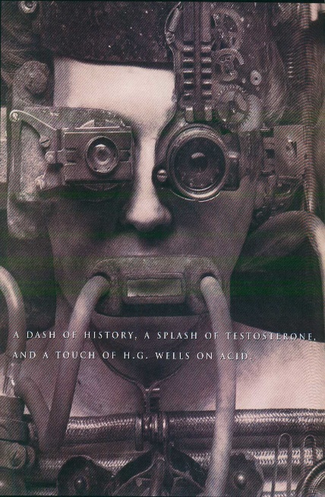
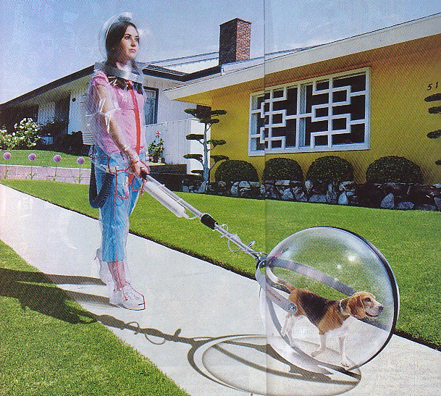
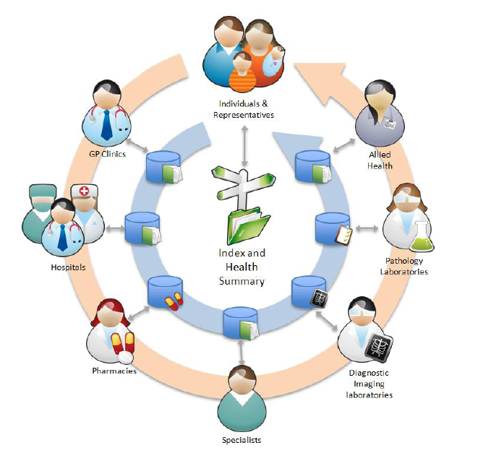

What is the future of your AI category, including your fears?

Slide 27
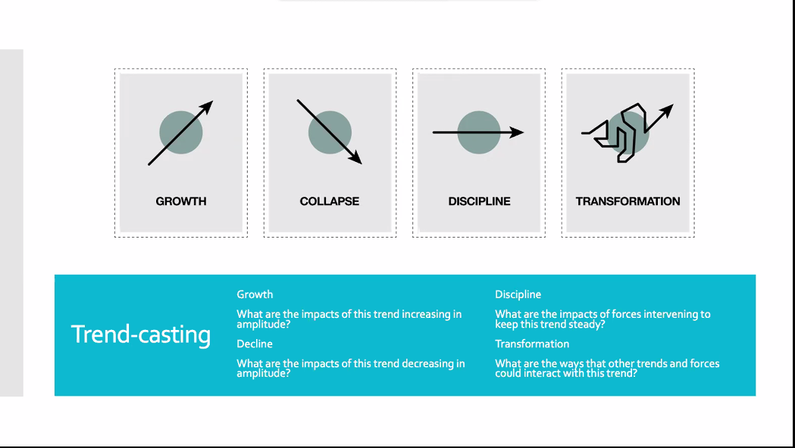

Slide 28
What is the answer to your
burning question?
In the Future ………
I fear that ………

Slide 29
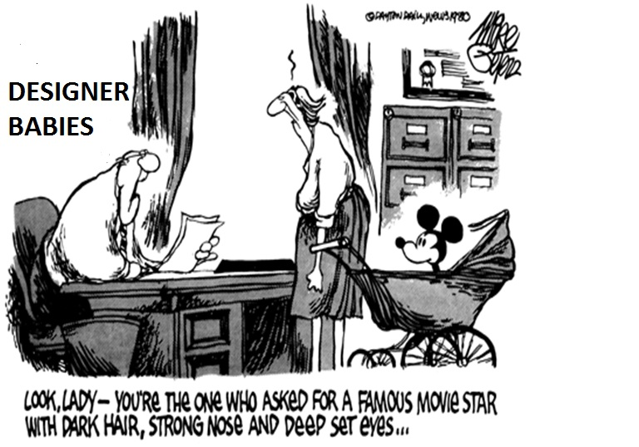
What are the Assumptions you have made?

Slide 30
Language is not Transparent
Mel Bochner

Slide 31


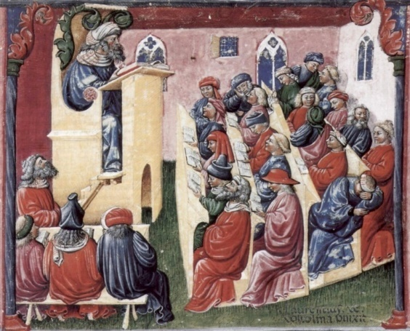

Slide 32



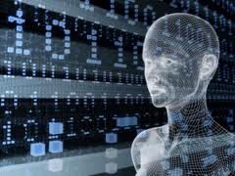

Slide 33

Mt Eliza Executive Education, Melbourne Business School,
Ranked Number 1 in Asia-pacific business schools

Slide 34
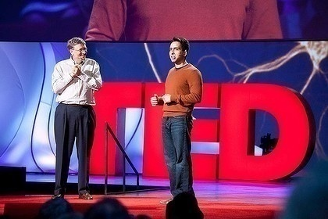

A global classroom – one Bangladeshi lecturer
Khanacademy.org
3400+ video lessons, 46,162,903 lessons delivered. All free. 170 million plus views
Notes:
MIT 40 million views

Slide 35


Creating alternative futures
Tradition, Accreditation
A la Carte - app university
One person, 50 million students
The garden university

Slide 36
Assumptions about Privacy

Slide 37
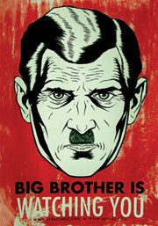
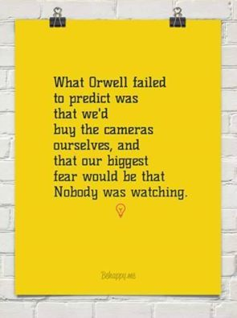
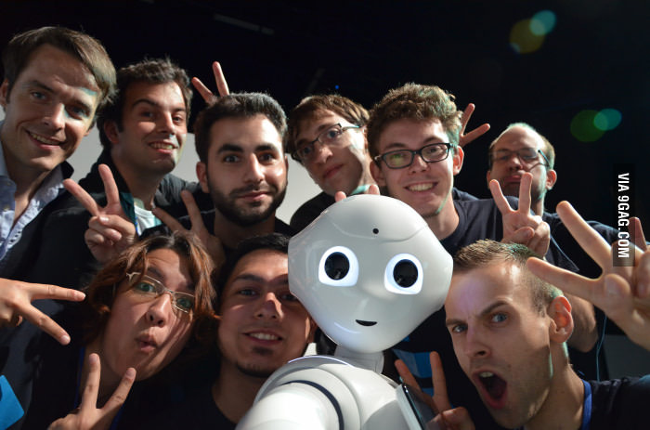

Slide 38
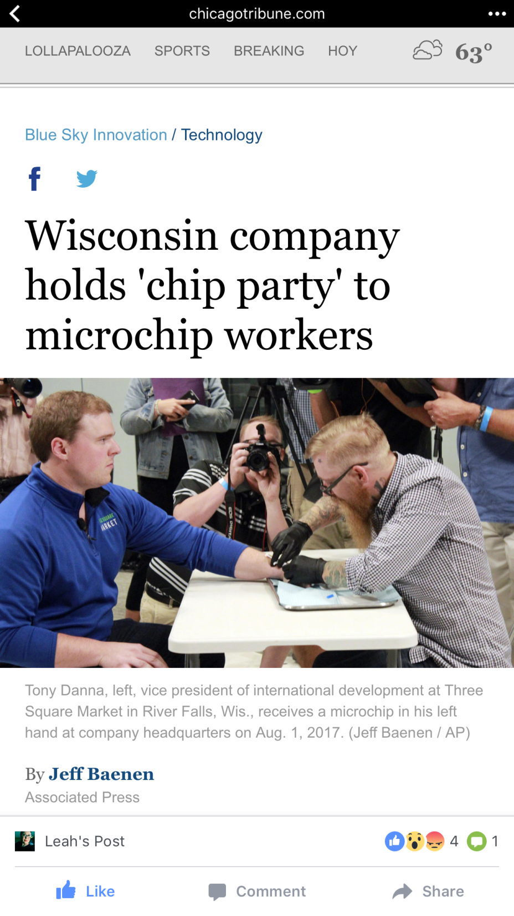
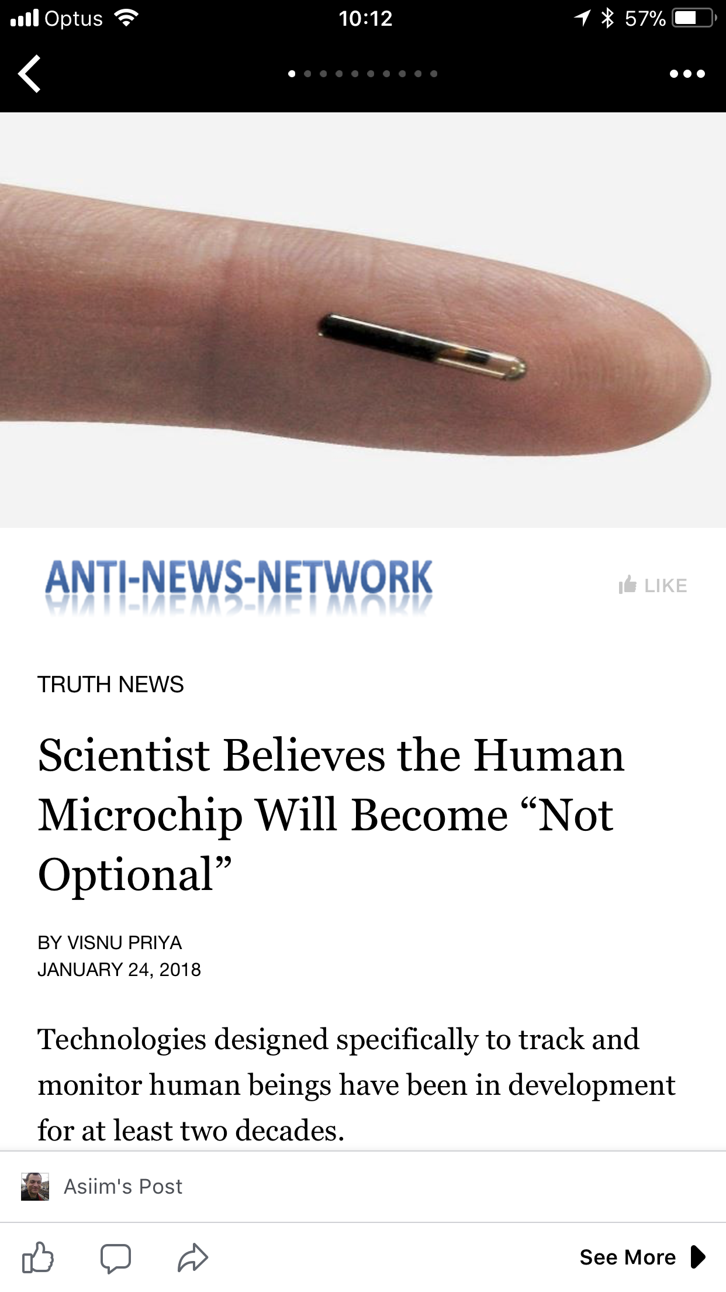
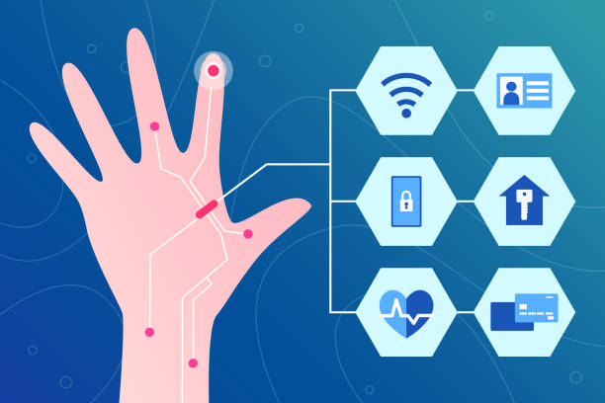

Slide 39
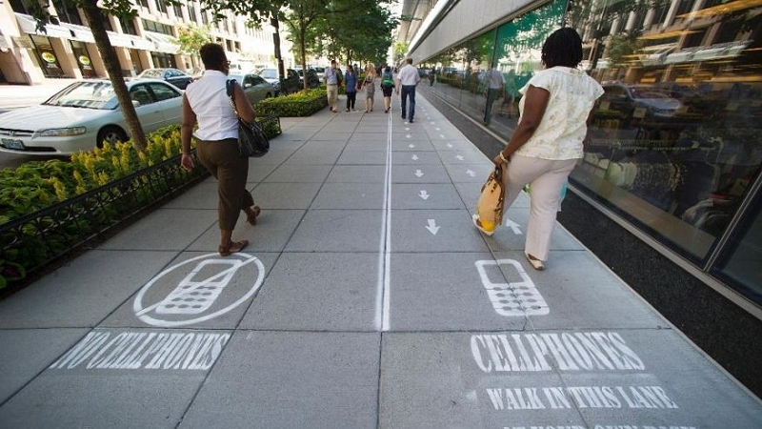

Slide 40
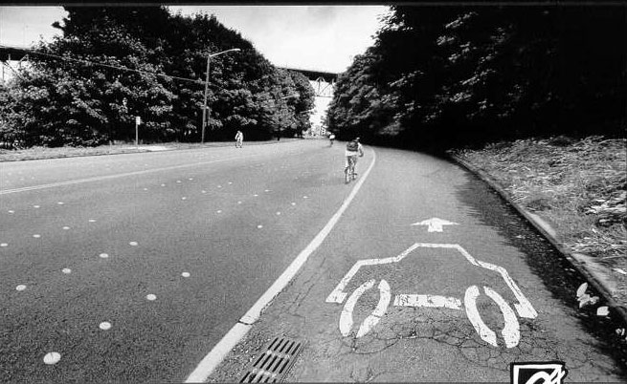
A dramatic different future

Slide 41

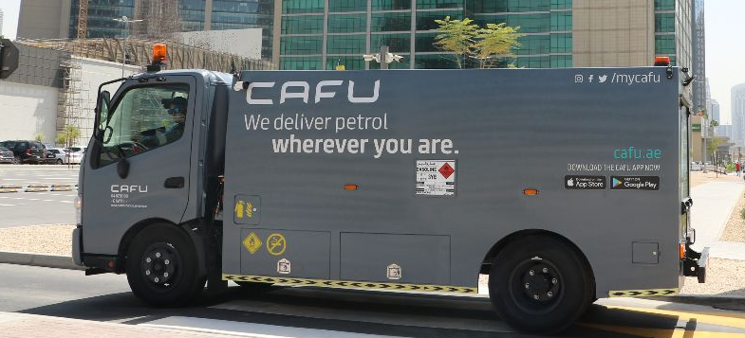

Slide 42
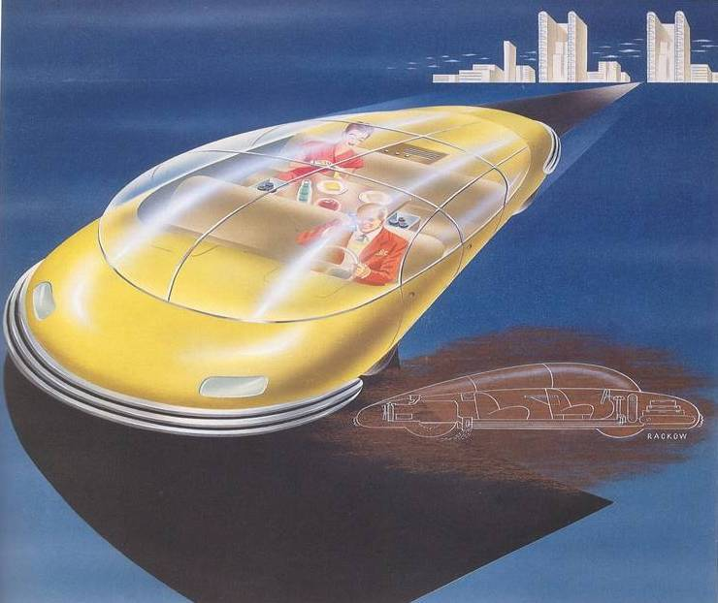
Unpacking assumptions

Slide 43
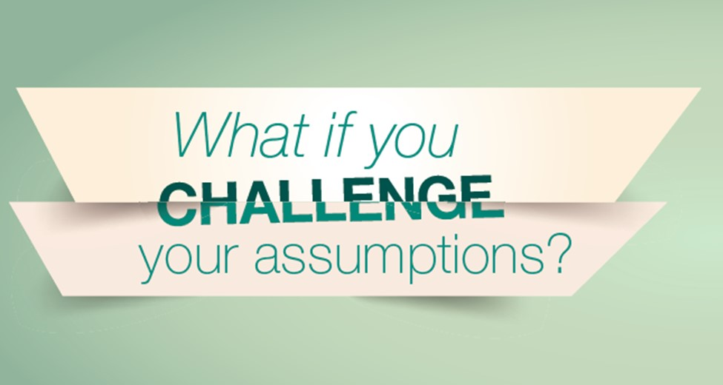

Slide 44
The Need for Deconstruction of Stories
Acceptance of Abuse
Gender Roles
Cultural Stereotypes
Insensitivity to Suffering

Slide 45
From Deconstruction to Reconstruction
Children at preschool age do not just listen to a story or sing a rhyme or learn their vocabulary. They keenly engage with them, relate to their characters and situations, develop mental categories and cultural sensibilities, and try to imagine their world through them.
Our children deserve better stories (and rhymes), and they have a right to wholesome childhood experiences that would nurture their hearts and minds and help them become conscious and caring human beings.

Slide 46
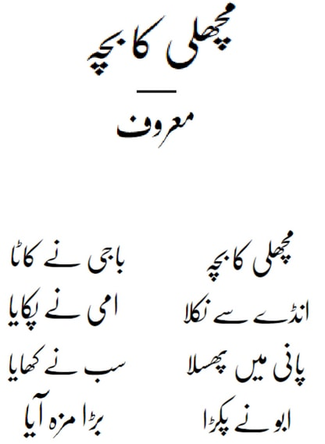
Insensitivity to Suffering
Jack and Jill went up the hill
To fetch a pail of water
Jack fell down and broke his crown
And Jill came tumbling after

Slide 47

Acceptability of abuse
Cinderella (emotional abuse of a child by stepmother and stepsisters),
Rapunzel (sacrifice of a female child by her parents;
imprisonment and mental abuse by a witch)
Beauty and the Beast ( sacrifice of a female child to save patriarch)
Snow White (physical abuse which evolves into attempted murder)
Hansel and Gretel (child neglect and abandon by parents, physical abuse and attempted murder by witch)
The Little Red Riding Hood (well established reputation of the wolf as a child predator)

Slide 48
Reconstruction
Possible strategies:
1. Using new and contemporary stories. Revising stories in the curriculum which promote violence, gender and cultural stereotypes.
2. Retelling of the traditional, widely known stories.

Slide 49
Advantages of the second approach (retelling of familiar stories)
Implicit critique of less desirable way of behaving and communicating.
2. Explicit description of desired ways of behaving and communicating. Educating about available alternatives.
3. Promotion of critical literacy amongst children (i.e. how to make informed choice between alternative ways of behaving and communicating with others).
4. Promotion of dialogue.
5. Inspiring creativity – children writing their own stories.

Slide 50
New Stories for Different Presents and Futures
• Removal of stereotypes
• New gender roles, positive gender models
• Contemporary subjects/problems: image issues, substance abuse, violence in schools, ecological damage
• Critical reading of traditional stories followed by creating of different versions of stories, inspiring creativity
• Development of environmental education

Slide 51
Deconstruction of destructive stories/narratives
Traditional (insensitivity to suffering):
Jack and Jill went up the hill
To fetch a pail of water
Jack fell down and broke his crown
And Jill came tumbling after
Rewritten:
Jack and Jill went up the hill
To fetch a pail of water.
Jack fell down, but didn’t frown,
And Jill came laughing after.

Slide 52


Slide 53
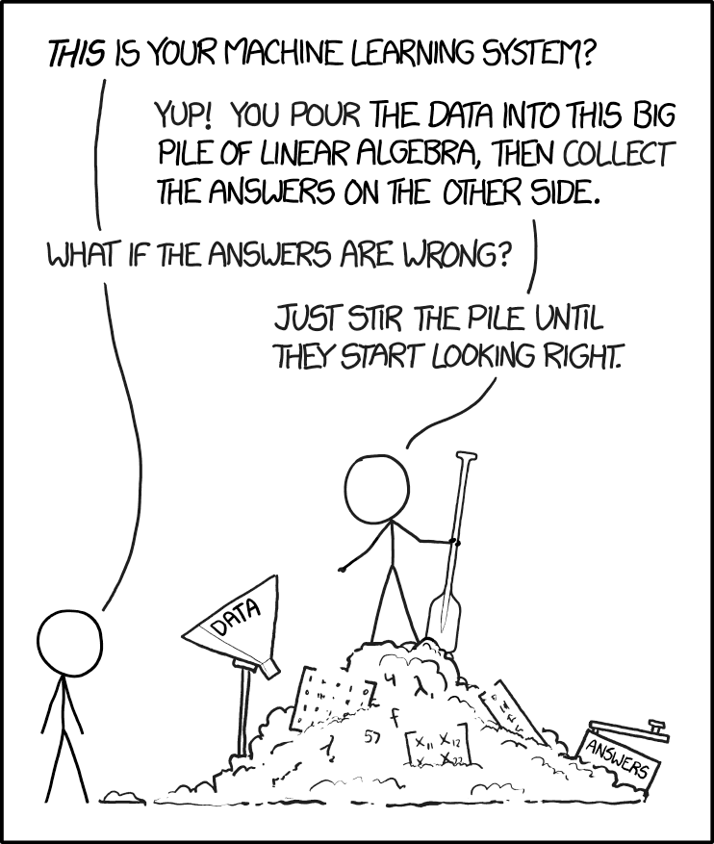
Lies, Damned lies, and Statistics

Slide 54
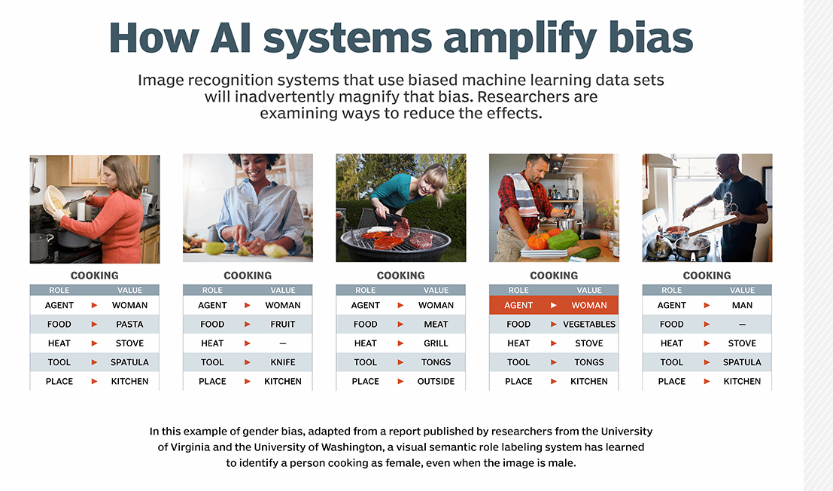

Slide 55
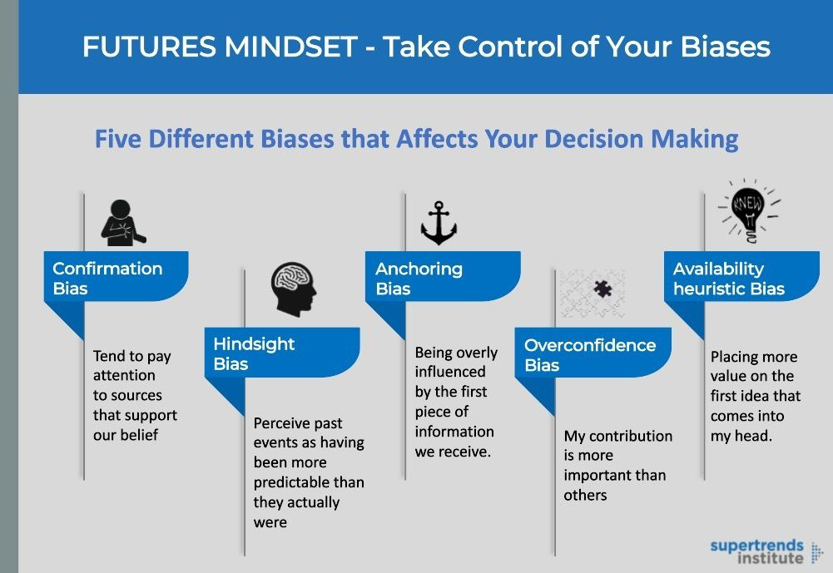

Slide 56
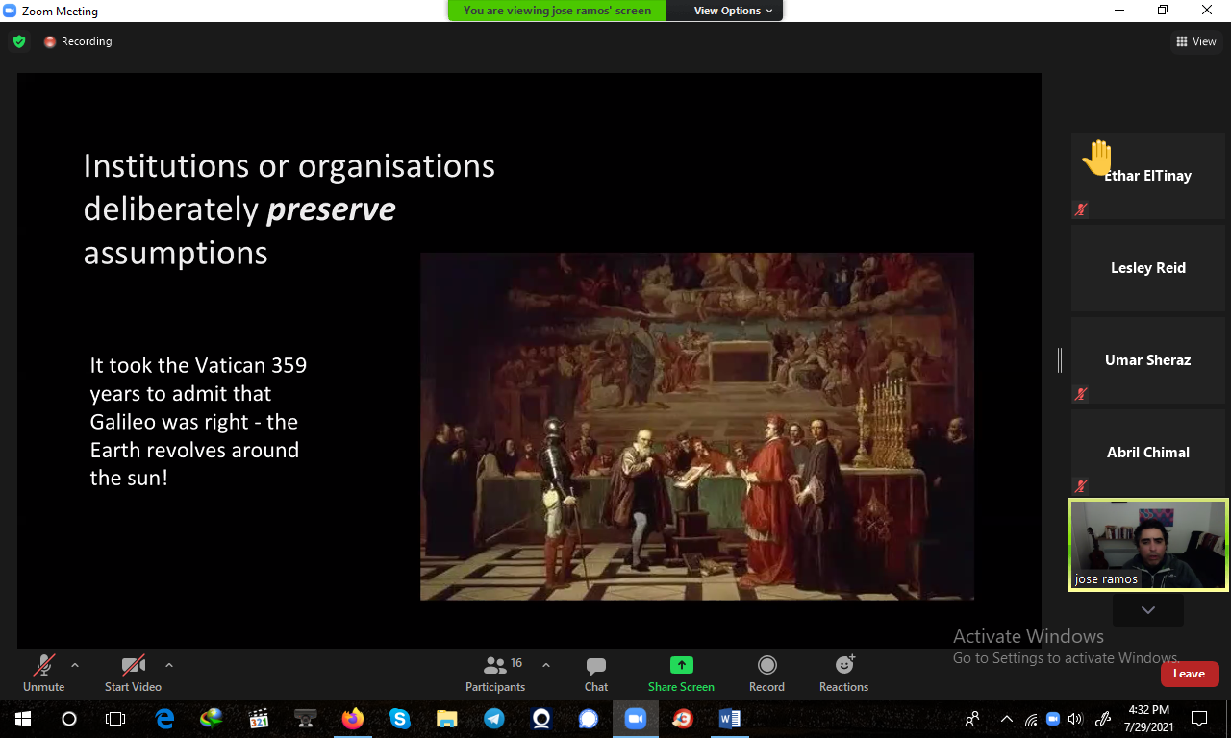

Slide 57
What is bias in AI?
• Explicit, rule-based AI:
IF
sees(system,
me)
THEN
output(‘You
are
right!’)
IF
sees(system,
my(archenemy))
THEN
greet(‘You
are
wrong!’)

Slide 58
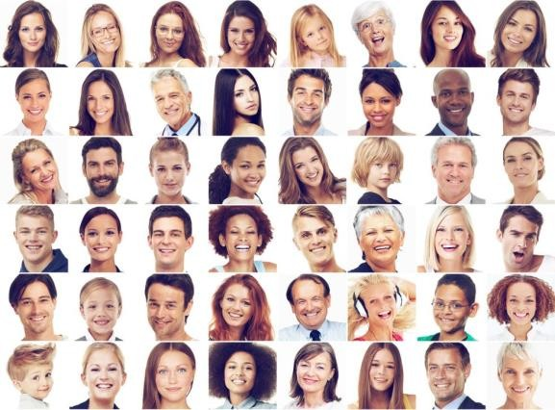


What is bias in AI?
Explicit, rule-based AI:
•
IF
sees(system,
me)
THEN
output(‘You
are
right!’)
IF
sees(system,
my(archenemy))
THEN
greet(‘You
are
wrong!’)
•
‘black-box’
shallow NN:
train
on
•
‘black-box’
deep NN:

Slide 59
What is bias in AI?
Explicit, rule-based AI:
•
IF
sees(system,
me)
THEN
output(‘You
are
right!’)
IF
sees(system,
my(archenemy))
THEN
greet(‘You
are
wrong!’)
•
‘black-box’
shallow NN:
train
on
You are right!
Input
Hidden Layer
Output
You are wrong!
•
‘black-box’
deep NN:

Slide 60
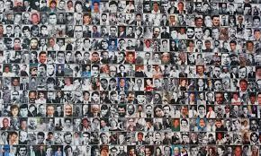
What is bias in AI?
Explicit, rule-based AI:
•
IF
sees(system,
me)
THEN
output(‘You
are
right!’)
IF
sees(system,
my(archenemy))
THEN
greet(‘You
are
wrong!’)
•
‘black-box’
shallow NN: train on
You are right!
Input
Hidden Layer
Output
You are wrong!
•
‘black-box’
deep NN: train on

Slide 61
What is bias in AI?
Explicit, rule-based AI:
•
IF
sees(system,
me)
THEN
output(‘You
are
right!’)
IF
sees(system,
my(archenemy))
THEN
greet(‘You
are
wrong!’)
•
‘black-box’
shallow NN: train on
You are right!
Input
Hidden Layer
Output
You are wrong!
•
‘black-box’
deep NN: train on
You are
right!
…
Output
Input
Hidden Layer
Hidden Layer
Hidden Layer
You are wrong!

